Slide 1


Railway Reservation System

Slide 2

TEAM MEMBERS:
A.Venkata Dinesh Reddy
(RA1911028010098)
CH.Vamshi Krishna
(RA1911028010099)
Kannanoor Spurgeon
(RA1911028010109)

Slide 3

Abstract:
The Railway Reservation System facilitates the passengers to enquire about the trains available on the basis of source and destination, Booking and Cancellation of tickets, enquire about the status of the booked ticket, etc. The aim of case study is to design and develop a database maintaining the records of different trains, train status, and passengers.
This project contains Introduction to the Railways reservation system .It is the computerized system of reserving the seats of train seats in advanced. It is mainly used for long route. On-line reservation has made the process for the reservation of seats very much easier than ever before.

Slide 4
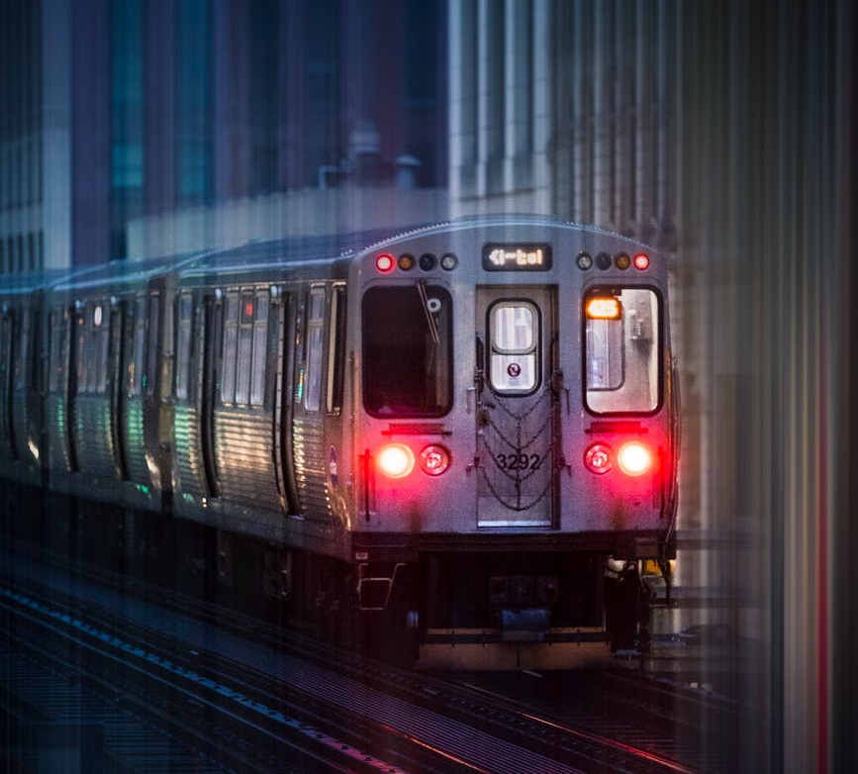
Purpose: The main purpose of maintaining database for Railway Reservation System is to reduce the manual errors involved in the booking and cancelling of tickets and make it convenient for the customers and providers to maintain the data about their customers and also about the seats available at them. Due to automation many loopholes that exist in the manual maintenance of the records can be removed. The speed of obtaining and processing the data will be fast. For future expansion the proposed system can be web enabled so that clients can make various enquiries about trains between stations. Due to this, sometimes a lot of problems occur and they are facing many disputes with customers. To solve the above problem, we design a data base which includes customer details, availability of seats in trains, no of trains and their details.

Slide 5
Functionalities of our project are:
Concurrency: Concurrent access to the same database by multiple users
Security: Security rules to determine access rights of users
Backup and recovery: Processes to back-up the data regularly and recover data if a problem occurs
Integrity: Database structure and rules improve the integrity of the data
Data descriptions: A data dictionary provides a description of the data

Slide 6
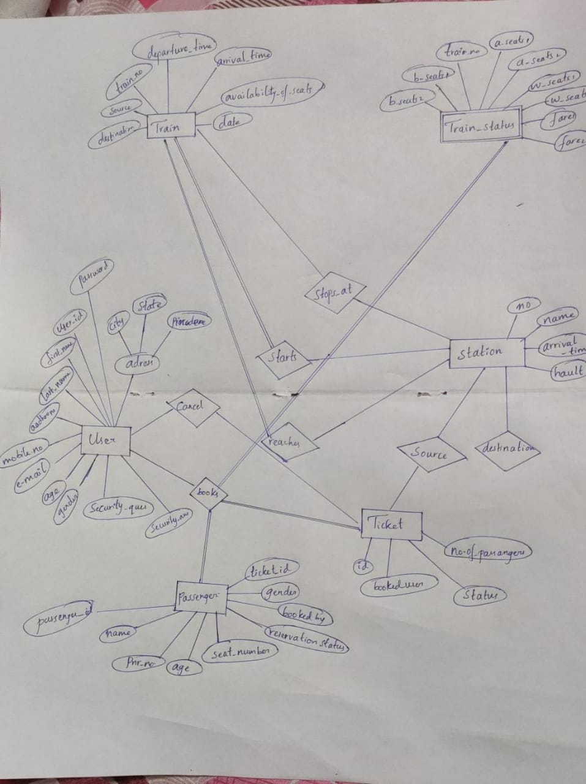
ER Diagram

Slide 7

Thank You

